Slide 1
EpiTrax Export
Creating and Running Reports

Slide 2
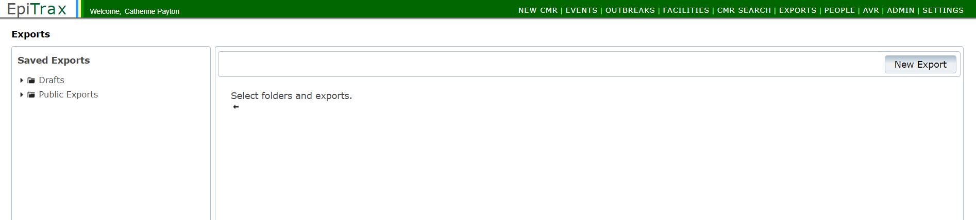
Getting Started

Slide 3
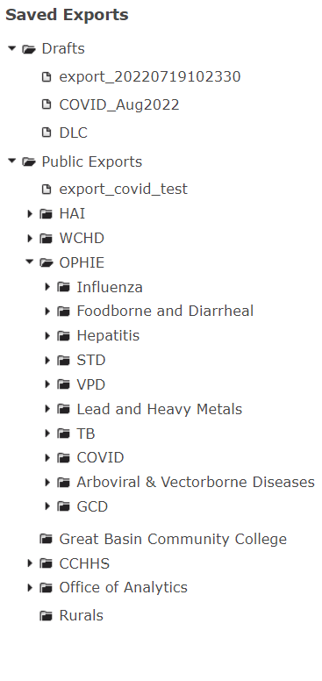
Getting Started Continued
Drafts: use this for personal reports.
Example: QA reports for management
Public Exports: use this for jurisdiction wide reports.
Example: Reports used by more than one team member

Slide 4
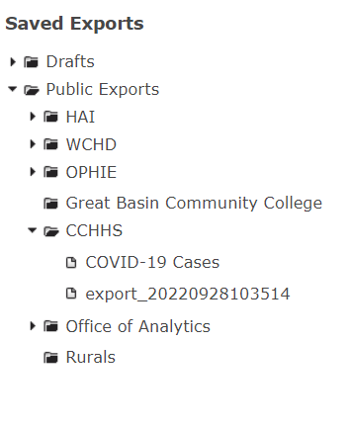
Getting Started
***Only create reports in your jurisdiction’s folder.

Slide 5
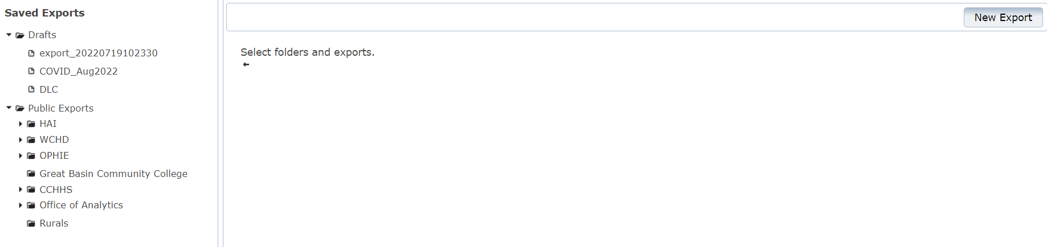
Creating a New Report
Click into the folder you want to put a report in
Click the New Export Button

Slide 6
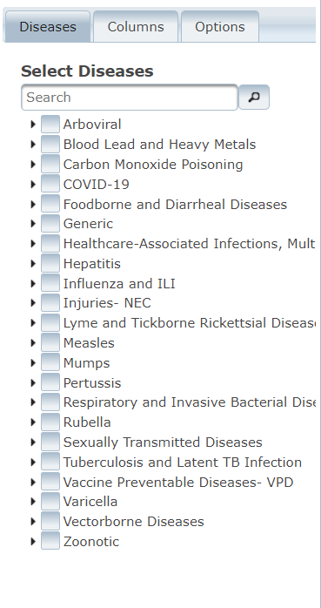
Select Conditions
3. Select this condition(s) you would like to include in the report

Slide 7
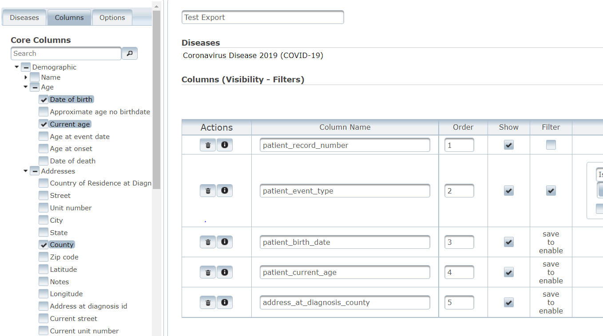
Select Reporting Variables
4. Click into the Columns tab
5. Click the dropdown next to the Core Columns to see all variables
6. Select the required reporting variables

Slide 8

Finalize Report
7. After selecting all of your variables, click Save

Slide 9
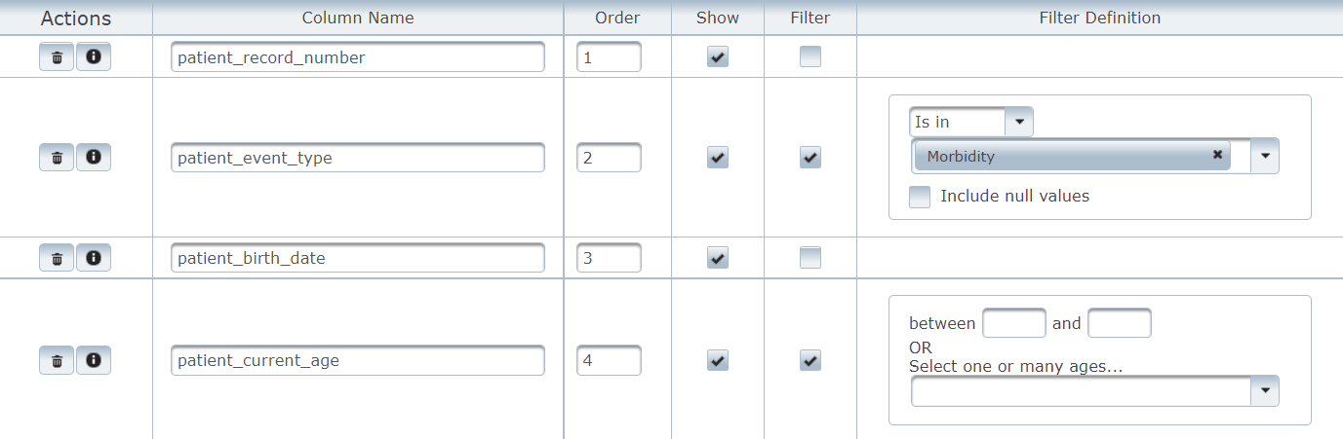
Filtering Select Variables
8. Click into the filter box to populate options
9. Enter required filters

Slide 10
Run the Report
10. Click Export to run your report

