Slide 1
Substance Use Prevention, Treatment and Recovery Services Block Grant Application FFY2027
Bryan Hernandez, SUPTRS Section Manager
Bureau of Behavioral Health Wellness and Prevention
September 14, 2026

Slide 3
Overview of the Bureau of Behavioral Health Wellness and Prevention (BBHWP)
Overview of Substance Use Prevention Treatment and Recovery Services Block Grant (SUPTRS BG)
Overview of SUPTRS Funding
  Federal Funds
  State General Funds
  Revenue Funds
Strategic Plan Priority Areas
SUPTRS BG Application Information
BHPAC Feedback Request and Public Review
Questions

Slide 4
Overview of BBHWP

Slide 5
Overview of BBHWP
BBHWP
Mental Health Branch
State Opioid Response (SOR)
Community Mental Health Services (CMHS)
Office of Data Management
Substance Use Branch
Crisis
Substance Use Prevention Treatment and Recovery Services (SUPTRS)
Certifications (BHCEN)

Slide 6
Overview of SUPTRS BG

Slide 7
Overview of SUPTRS BG
The Substance Use Prevention, Treatment, and Recovery Services Block Grant (SUPTRS BG) program provides funds to all 50 states, the District of Columbia, Puerto Rico, the U.S. Virgin Islands, the Northern Mariana Islands, Guam, American Samoa, 3 Pacific jurisdictions, and 1 tribal entity to prevent and treat substance use. The SUBG program’s objective is to help plan, implement, and evaluate activities that prevent and treat substance use.
The SUPTRS BG is authorized by section 1921 of Title XIX, Part B, Subpart II and III of the Public Health Service (PHS) Act. The PHS Act required the secretary of the U.S. Department of Health and Human Services to create regulations as a precondition to making funds available to the states and other grantees under the SUPTRS BG.
The SUPTRS BG program targets the following populations and service areas:
Pregnant women and women with dependent children
Injection drug users
Tuberculosis services (in select states)
Early intervention services for HIV/AIDS (in select states)
Primary prevention services

Slide 8
SUPTRS BG Grantee Requirements
Have a designated unit of its executive branch that is responsible for administering the SUPTRS BG
Apply annually for SUPTRS BG funds
Have the flexibility to distribute the SUPTRS BG funds to local government entities, such as municipal, county, or intermediaries, including administrative service organizations
Have SUPTRS BG sub-recipients, such as community- and faith-based organizations (non-governmental organizations), and deliver:
  Substance use prevention activities to individuals and communities impacted by substance Use
  Substance use disorder (SUD) treatment and recovery support services to individuals and families impacted by SUDs

Slide 9
Tobacco Use Prevention—Synar Amendment
The Synar Amendment to the 1992 Alcohol, Drug Abuse, and Mental Health Administration Reorganization Act (PL 102-321) aims to decrease youth access to tobacco.
The Synar legislation requires states to do the following:
  Enact laws prohibiting the sale and distribution of tobacco products to minors.
  Enforce such laws in a manner that can reasonably be expected to reduce the availability of tobacco products to youth under the age of 18.
  Conduct random, unannounced inspections of tobacco outlets.
  Report annual findings to the secretary of the U.S. Department of Health and Human Services by December 31 each year.
Partners in this space:
  Prevention Coalitions
  Nevada Attorney General’s Office
  DPBH, Office of Tobacco Control
  BBHWP staff

Slide 10
Overview of SUPTRS BG Funding

Slide 11
Overview of SUPTRS BG Funding
FFY 2027: SUPTRS BG $20,527,552
Spring 2025 – released competitive RFA for a 2-year subaward period.
Second year negotiations are being completed now.
Funding for the various selected programs will include:
Federal Funds: SUPTRS BG
State General Funds
Revenue Funds

Slide 12
Allocation of SUPTRS BG Funds
Primary Prevention Set-Aside establishes a minimum of 20% of expenditures by the grantee related only to primary prevention activities
Women’s services 5% set aside for pregnant women and women with dependent children
Synar requirement
Maximum of 5% for administrative requirements
Maintenance of effort
  Average of aggregate State expenditures for authorized activities for the 2-years preceding the year for which the State is applying for a grant

Slide 13
Federal Funds: SUPTRS BG
The SUPTRS BG is one of the main grants the Bureau manages for substance use initiatives.
Two-year performance cycle, with yearly budgetary allocations.
New year begins October 1, 2026.
BBHWP’s application to SAMHSA is due October 1, 2026.

Slide 14
Federal Funds: SUPTRS BG Only
Primary Prevention
  Prevention Coalitions: CARE Coalition, Join Together Northern Nevada, Nye Community Coalition, PACT Coalition, Partnership Douglas County, Churchill Community Coalition, Frontier Community Coalition, Health Communities Coalition
  Prevention Programs: New Frontier, UNR PEAT
  Regional Behavioral Health Coordinators: Nevada Public Health Foundation, Family Support Center, Washoe County, Clark County
Treatment
  Transitional Housing: Carson City Community Counseling Center, Living Free Health & Fitness, New Frontier, Ridge House, Rural Nevada Counseling, Step 1, Vitality, Westcare, Northern Nevada Hopes
  Wrap Around Services: Living Free Health & Fitness, UNR Prenatal Health, Westcare
  Court/Law: 8th Judicial (LIMA, Jail De-Population, MAT Specialty Court)
Recovery
  Foundation for Recovery, Tru Vista, Ridge House, RISE, Nevada Department of Veterans Affairs, Oxford House,
BHCEN Certifications: UNR CASAT
Operating costs and other operational agreements

Slide 15
Federal Funds: SUPTRS BG Only
Notes:
Both BG and related General funds
Carve-outs:
Required: PP, Women’s Services, Admin CAP
Recovery is not a mandated carveout, but Nevada has been one of the first states to intentionally fund and manage RSS within our BG.

Slide 16
State General Funds (Maintenance of Effort)
Subunit 10 is funding for substance use treatment and recovery initiatives:
  Transitional Housing: Step 2, Westcare, The Empowerment Center, Community Counseling Center, 8th Judicial District Court
  Recovery Support Services: Foundation for Recovery
Subunit 11 is funding for substance use prevention initiatives:
  Primary Prevention Activities: PACE Coalition, Grant a Gift Foundation, Nevada Cancer Coalition
Subunit 19 is funding for problem gambling initiatives:
  Problem Gambling: Birches Health, International Problem Gambling Center, Mental Health Counseling and Consulting, Nevada Council on Problem Gambling Inc, UNLV
Notes:
11 – certified substance use prevention coalitions and prevention programs

Slide 17
Revenue Funds
  Subunit 14 (Alcohol Tax) is funding substance use initiatives in our community (NRS 458.097):
    Jail-based Forensic Assessment Services Triage Team (FASTT): Carson City Community Counseling Center (Carson), Churchill County, Lyon County, Nye County Community Coalition (Nye), and Partnership Douglas County (Douglas)
    Mobile Outreach Safety Team (MOST): Lyon County
    Transitional housing: The Empowerment Center, Northern Nevada Hopes
      Subunit 16 revenue is generated from certification fees and funds a portion of the BHCEN certifications for substance use prevention and treatment agencies (NAC458.103).
Subunit 50 (Cannabis Tax) is funding substance use treatment initiatives in our community (NRS 678C.830):
  Case management for substance use specialty courts relating to child welfare in Washoe and Clark Counties.

Slide 18
Strategic Plan Priority Areas

Slide 19
SUPTRS BG
BBHWP Strategic Plan (2025-2030) drove the substance use funding efforts being outlined in the application for the SUPTRS BG :
Strategy 2.1 Strengthen and Sustain Nevada’s Behavioral Health Workforce
Strategy 3.1 Expand and Stabilize Foundational Supports
Strategy 4.1 Reduce Stigma and Strengthen Community Engagement Around SUD
Strategy 7.2 Strengthen family, peer and community-led support systems for youth and special populations

Slide 20
SUPTRS BG Application Information

Slide 21
SUPTRS BG Application Information
THE BBHWP administers SUPTRS BG and uses it to fund community-based prevention, treatment, and recovery providers through subawards and other agreements.
BBHWP submits a SUPTRS BG application to SAMHSA an on annual basis (full application every odd year, and a mini-application every even year).
This year’s application is a mini-application, which requires an update on the full application identified priorities.
Application reporting requirements include the following:
Budget information and planned spending
Plans for:
  Crisis services
  Advisory council
  Public comment
The mini-application for the upcoming fiscal year (FFY2027) is due to SAMHSA by October 1, 2026.

Slide 22
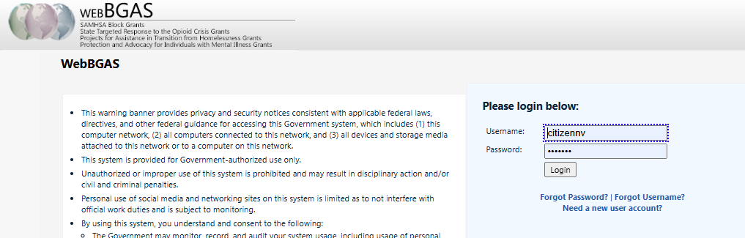
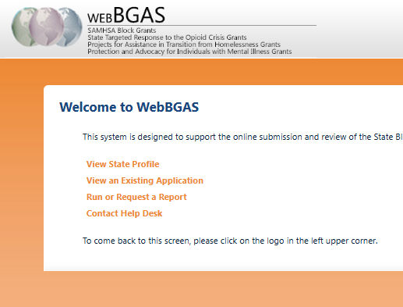
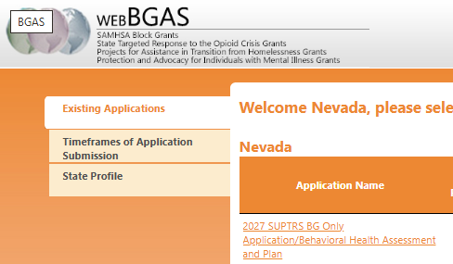
SUPTRS BG Application Information
Step 1:
https://bgas.samhsa.gov
Here is what it looks like online in WebBGAS.
Step 2:
Step 3:

Slide 23
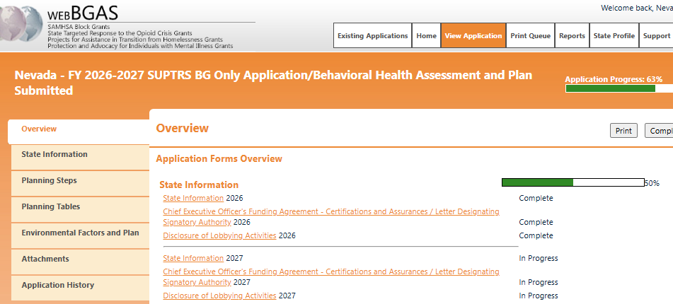
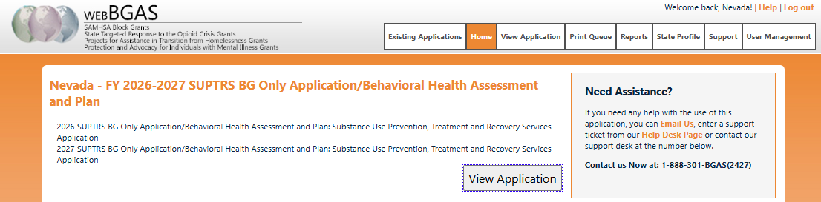
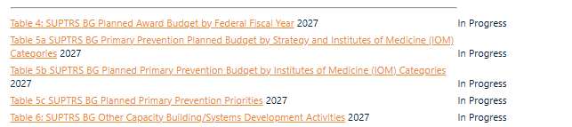
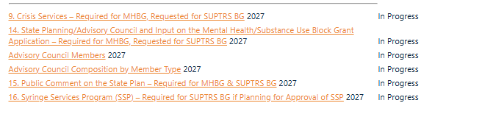
SUPTRS BG Application Information
Step 5:
We are completing all sections marked 2027.
Step 4:

Slide 24
BHPAC Feedback Request and Public Review

Slide 25
BHPAC Feedback Request
We are asking for your feedback on the Substance Use Prevention Treatment and Recovery Services Block Grant application.
BHPAC members may provide individualized feedback to the state, or compile feedback in one letter through the BHPAC Chair.
The application can be viewed by:
Going to https://bgas.samhsa.gov
Using the following sign on credentials
  Username: citizennv
  Password: citizen

Slide 27
Bryan George Hernandez
SUPTRS Section Manager
bghernandez@health.nv.gov

Slide 28
BBHWP: Bureau of Behavioral Health Wellness and Prevention.
SUPTRS BG: Substance Use Prevention, Treatment, and Recovery Services Block Grant.
DPBH: Division of Public and Behavioral Health.
SOR: State Opioid Response.
CMHS: Community Mental Health Services.
BHCEN: Behavioral Health Certifications for Excellence (Certifications branch supporting substance use prevention/treatment agency certification).
SUD: Substance Use Disorder.
TB: Tuberculosis (services referenced for select states).
HIV/AIDS: Human Immunodeficiency Virus / Acquired Immunodeficiency Syndrome (early intervention services referenced for select states).
Synar Amendment: Federal tobacco compliance law requiring states to prevent youth access to tobacco.
FFY: Federal Fiscal Year.
RFA: Request for Applications (competitive funding release).
SAMHSA: Substance Abuse and Mental Health Services Administration.
FASTT: Forensic Assessment Services Triage Team (jail-based program).
MOST: Mobile Outreach Safety Team.
NRS: Nevada Revised Statutes.
NAC: Nevada Administrative Code.
BHPAC: Behavioral Health Planning and Advisory Council.
WebBGAS: Federal grant application system used for SUPTRS BG submissions.

