Slide 1
Stopping the Cascade:
Reducing the burden of Chronic Kidney Disease by preventing or managing type 2 diabetes
Amber Hise, RD
Chronic Disease Prevention and Health Promotion Section Manager
April 30, 2024

Slide 2

Introduction and overview
Current funding and support
Statistics for Nevada
Diabetes prevention
Diabetes management
Barriers and challenges
Next steps
Q & A
Contacts and acronyms

Slide 3
Introduction and Overview
Chronic Disease Prevention and Health Promotion Section (CDPHP)
Diabetes Prevention and Control Program (DPCP)
DPCP team
  Sarah Rogers, MPH, NDTR, CLC – Nutrition Unit Deputy Chief and Grant Principal Investigator
  Amber Hise, RD – CDPHP Section Manager
  Godwin Nwando, MPH – Program Manager
  TBA – Diabetes Coordinator
  TBA– Evaluator

Slide 4
Funding
CDC DP23-0020 award
  2023 – 2028
~ $900,000 per year
Subawards
  Sanford Center for Aging at UNR (SCA)
  Roseman University of Health Sciences (Roseman)
  Nevada Business Group on Health (NVBGH)

Slide 5
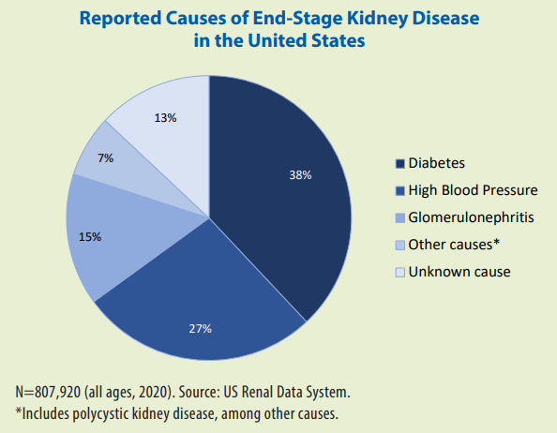
Nevada Statistics
Nevada prevalence
  Type 2 Diabetes Mellitus (T2DM) - 10.6%
  Prediabetes – 35.1%
  Chronic Kidney disease (CKD) – 13.9% (U.S./crude)
“Diabetes mellitus has emerged as the most important risk factor for CKD in the developed world.”
As with prediabetes, around 90% of people with CKD are unaware of their disease status
Chronic Kidney Disease in the United States, 2023 (cdc.gov)

Slide 6
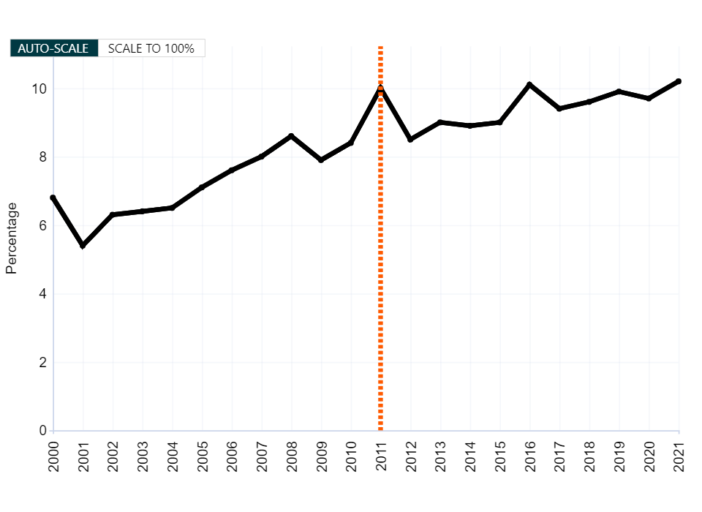
Diagnosed Diabetes, Total, Adults Aged 18+ Years, Age-Adjusted Percentage, Nevada
Source:
USDSS
Major changes to the survey methods in 2011
Horizontal dotted line indicates "No Data", "Suppressed Data" or both.
Disclaimer: This is a user-generated report. The findings and conclusions are those of the user and do not necessarily represent the views of the CDC.
National Center for Chronic Disease Prevention and Health Promotion
Division of Diabetes Translation

Slide 7
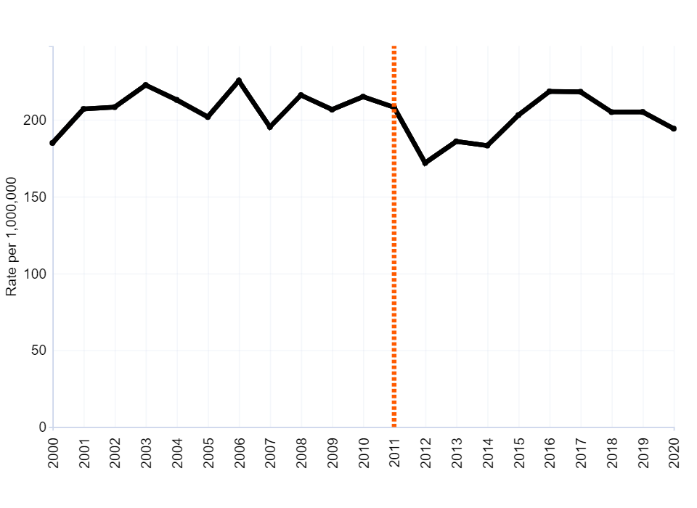
Diabetes Related ESRD Incidence, Total, Adults Aged 18+ Years, Age-Adjusted Rate per 1,000,000, Nevada
Source:
USDSS
Major changes to the survey methods in 2011
Horizontal dotted line indicates "No Data", "Suppressed Data" or both.
Disclaimer: This is a user-generated report. The findings and conclusions are those of the user and do not necessarily represent the views of the CDC.
National Center for Chronic Disease Prevention and Health Promotion
Division of Diabetes Translation

Slide 8

Diabetes Prevention
The National Diabetes Prevention Program (National DPP)
  # and type of program offerings
  Employer and TPA coverage
Outreach and education
  Patients
  Providers
Coordination with other State programs

Slide 9
Diabetes Management
Diabetes Self-Management Education and Support (DSMES)
  # and type of program offerings
  Employer and TPA coverage
Medication Therapy Management (MTM)
Outreach and education
  Patients
  Providers

Slide 10

Barriers and Challenges
Coordinating programs and activities
Sustainable funding
  Grant funding
  Medicaid + Medicare
  Insurance and TPAs
Reaching priority populations
  Spanish-speaking
  65+
  Underserved groups
  Rural populations

Slide 11
Next steps
Education
  Prediabetes
  Kidney disease
Test people with T2DM for CKD
Coordinate efforts for address hypertension, T2DM, and CKD
  Continuous Glucose Monitoring & flash Glucose Monitoring coverage in Medicaid
  Nevada 5210
  Nevada Cardiovascular Health Program
Focus on lifestyle change

Slide 12
Questions

Slide 13
Amber Hise, RD
Chronic Disease Prevention & Health Promotion (CDPHP), Section Manager
(775) 461-6749
ahise@health.nv.gov
Godwin Nwando MPH
Community Wellness Unit Manager
(775) 443-2979
gnwando@health.nv.gov

Slide 14
CDC – the U.S. Centers for Disease Control and Prevention
CGM – continuous glucose monitors
CKD – chronic kidney disease
T2DM – type 2 diabetes mellitus
TPA – third-party administrators (usually for insurance plans)
UNR – University of Nevada, Reno

